Slide 1
Optimal Methods for Computing Kinematics Using Motion Capture Data

Slide 2
Optimal Methods for Tracking
Rigid Bodies
Take advantage of the known relationship between the tracking targets and the underlying rigid bodies to minimize the effects of errors.

Slide 3
Optimal Methods
(number of targets per segment)
So what are minimum and maximum number of targets that can be used to track an anatomical segment?

Slide 4
Degrees of Freedom
Number of independent parameters that are necessary and sufficient to uniquely define the position and orientation of a rigid body (or system of bodies)

Slide 5
Generalized Coordinates
Set of independent parameters that are necessary and sufficient to uniquely define the position and orientation of a rigid body (or system of bodies)

Slide 6
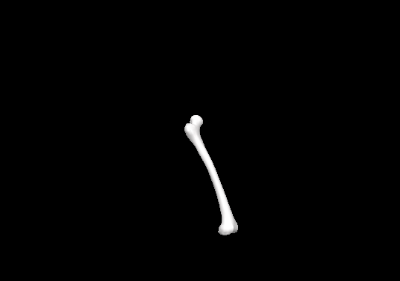
Degrees of Freedom
Y
How many degrees of freedom does the femur have?
Answer: 6 dof
Generalized coordinates: 3 translational (X,Y,Z),
3 rotational θx, θy, θz
X
Z

Slide 7
Degrees of Freedom
Y
How many independent pieces of information do we get
from one target?
X
Answer: 3 (X, Y, Z)
Z

Slide 8
Degrees of Freedom
Y
How many independent pieces of information do we get
from the second target?
Answer: 2
X
We have one constraint :
distance between the targets is fixed
Z

Slide 9
Degrees of Freedom
Y
How many independent pieces of information do we get
From the third target?
Answer: 1
X
We have two constraints:
distances between the targets are fixed
Z

Slide 10
Degrees of Freedom
How many independent pieces of information do we get
From the fourth target?
Y
Answer: 0
System is over determined – Least Squares Solution Required
X
Z

Slide 11
Because Optimal Methods use a Least Squares Approach:
Thus Minimum Number of Targets =3
Maximum Number of targets is “unlimited”

Slide 12
Optimal Methods for Tracking
Rigid Bodies (6 DOF Approach)
The transformation between anatomical and global space is given by:
If the data is not perfect there is an error for each target given by:
Solve for R and O minimizing the expression:
Under the constraint that R be a rotational transformation:

Slide 13
Optimal Methods for Tracking
Rigid Bodies (6 DOF Approach)
Solve for R and O minimizing the expression:
Under the constraint that R be a rotational transformation:
How do we solve the minimization under the constraint:
Visual3d uses Spoor and Veldpaus, 1980, which is based on the method of
Lagrangian Multipliers. (Other optimization techniques can also be used:
Veldpaus et al 1988, Lu and O’Connor 1999 etc...)
We will now briefly cover Spoor and Velpaus and later in the course discuss
Optimization in general and also cover Lu and O’Connor.

Slide 14
Lagrangian Multipliers

Slide 15
Lagrangian Multipliers
(from Introduction to Lagrangian Multipliers: Steuard Jensen)
Minimization under a constraint
Mathematically why is it needed:
Problem: How do I minimize the amount of aluminum needed to make a can?
Solution: Make a really small can
However the real problem: How do I minimize the amount of aluminum need to make
a can that still holds 12 oz of beer?
We have a minimization problem and a constraint (in bold).

Slide 16
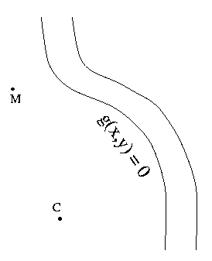
Lagrangian Multipliers: How they work
The Milkmaid Problem
Consider a milkmaid (M) and a Cow (C). Our milkmaid
has to first go to the river, g(x,y)=0 , wash her bucket
and then milk the cow. However she is in a hurry and
wants to do her chore as quickly as possible and thus
needs to find the shortest possible path from her current
position to the river and then the cow.

Slide 17
Lagrangian Multipliers: How they work
The Milkmaid Problem
Mathematically the milkmaid needs to find the
point (P) along the river such that the distance
from M to P, d(M,P), plus the distance from
P to C, d(P,C) is minimized.
Our problem not only contains a minimization
(minimize the distance) but also a constraint:
point P must lie on the river bank.
Formally, we must minimize the function
f(P) = d(M,P) + d(P, C), subject to the constraint that
g(P) = 0.
P

Slide 18
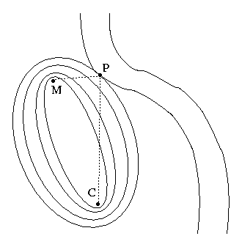
Lagrangian Multipliers: How they work
The Milkmaid Problem: Graphical Interpretation
Let’s take advantage of the geometric rule that for
every point P on a given ellipse, the total distance
from one focus of the ellipse to P and then to the
other focus is exactly the same.
In our problem, that means that the milkmaid
could get to the cow by way of any point on a given
ellipse in the same amount of time.
Therefore, to find the desired point P on the
riverbank, we must simply find the smallest
ellipse that intersects the curve of the river
P

Slide 19
Lagrangian Multipliers: How they work
The Milkmaid Problem: Graphical Interpretation
It is obvious from the picture that the "perfect"
ellipse and the river are truly tangential to each
other at the ideal point P. More mathematically,
this means that the normal vector to the ellipse is
in the same direction as the normal vector to the
Riverbank.
P

Slide 20
Lagrangian Multipliers: How they work
The Milkmaid Problem: Graphical Interpretation
In calculus, the gradient of a function ( ) is a normal
vector to any curve of surface. The length of the
normals don’t matter and in our case we have two
normals which are parallel and thus:
P
λ
λ
is the Langrangian multiplier

Slide 21
Lagrangian Multipliers: How they work
The Milkmaid Problem: Graphical Interpretation
Goal: to solve for P, more specifically the x and y
values of P
We have 3 unknowns:
x, y and
We have 3 equations :
The equation for the gradient is a vector
equation, so it supplies to two equations of
constraint.
The third equation is our original equation g(x,y)=0.
Thus mathematically we can find x, y and
and thus find the shortest distance
λ
P
λ
Gradient equation:
λ

Slide 22
Let’s Return to our Optimal Methods for Tracking
Rigid Bodies (6 DOF Approach)

Slide 23
Optimal Methods for Tracking
Rigid Bodies (6 DOF Approach)
Solve for R and O minimizing the expression:
Under the constraint function (now re-arranged) with a Lagrangian multiplier:
λ
λ
Thus like our milkmaid problem we have two function. One function we wish to
Minimize f(R,O) and one constraint function g(R, ).
λ

Slide 24
Optimal Methods for Tracking
Rigid Bodies (6 DOF Approach)
Thus again like the Milkmaid problem, to find the minimized solution under the
constraint we take the partial derivative (gradient) of the combined equation and set
it equal to zero:
λ
The details of the solution (R and O) are give in Spoor and Veldpaus 1980.

Slide 25
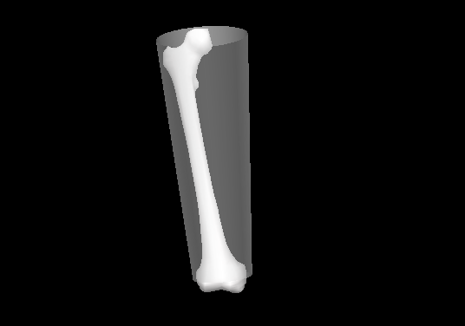
Optimal Methods for Tracking
Rigid Bodies (6 DOF Approach)
Calibration
Find the anatomical based coordinate
system (same as last week): R and O
P’3
2) Find the vector (P) from
origin to one of the Tracking targets
(in Lab Coordinate System)
P’1
P’2
3) Transform P into the anatomical coordinate
system (P’)
O
Z
P1
4) Repeat steps 2-4 to find P’ for all other tracking targets
Y
X

Slide 26
Optimal Calibration:
Building the Anatomical Coordinate Systems
Finding the local coordinates of the tracking targets in the calibration trial
Anthropometrics, graphics scaling and graphing the calibration model

Slide 27
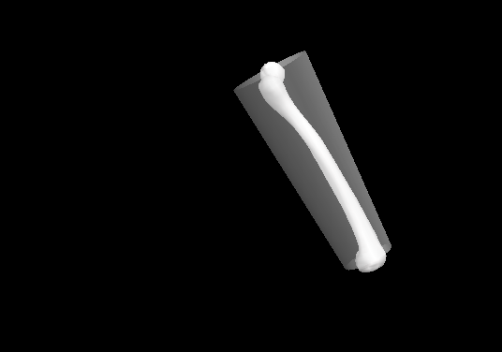
Optimal Methods for Tracking
Rigid Bodies (6 DOF Approach)
Step 2: Motion Trial
‘
1) Find the vector (P) from
origin to each tracking target
(in Lab Coordinate System)
P1
P1
2) Recall the stored vector (P’)
from local origin to each tracking
target (in anatomical coordinate
system)
O
Z
3) Find R and O using the function:
Y
X

Slide 28
Optimal Methods for Tracking
Rigid Bodies (6 DOF Approach)
Uses rigid body assumptions to reduce the effects of error
Allows the system to be over-determined
(> 3 tracking targets)
Segments can still be measured if a target drops out
Increased flexibility in tracking target placement

Slide 29
Inverse Kinematics
Inverse Kinematics is the process of determining the
parameters (generalized coordinates) required by
kinematic chain to achieve a desired pose

Slide 30
(Non)Inverse Kinematics
θ2
θ1
Specify the angles
compute the path of the end effector

Slide 31
Inverse Kinematics
θ2
θ1
Given the path of the end effector
compute the required angles

Slide 32
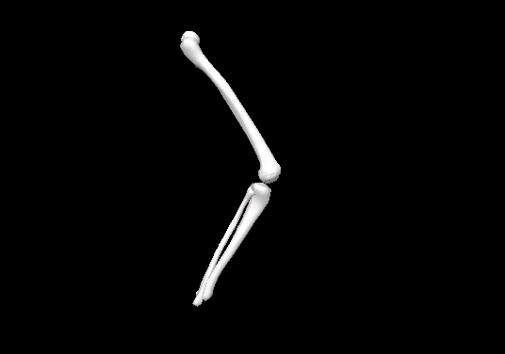
Inverse Kinematics
Example: Thigh that has 6 dof (root) with a shank connected via hinge joint
y’
7 Generalized coordinates (q) are:
z’
x’
Px
Py
Pz
Θx_thigh
Θy_thigh
Θz_thigh
P
Y
Θx_knee
Z
X
Our single Pose expression becomes

Slide 33
Inverse Kinematics
Lets look at our example for one target on the shank
y’
z’
x’
For more then one target:
Y
L
X
A
Z
P

Slide 34
So for our Inverse Kinematics Problem
Our single Pose expression is:
We are once again at optimization problem (minimizing a cost
function) that will require a more general solution then we used
for getPose.

Slide 35
Inverse Kinematics: Optimization

Slide 36
System of Equations
2 Independent Equations w/ 2 Unknown:
Exact Solution (x=2, y=1)

Slide 37
System of Equations
3 Independent Equations w/ 2 Unknown:
Likely there is not an exact solution∴ Least Squares Solution

Slide 38
Optimization
From Previous Slide:
Introduce an Error Terms: ε

Slide 39
Optimization
Our solution minimizes the sum of the squared errors:
In general we minimize a cost function:

Slide 40
Optimization
One minimization approach we already explored was Spoor
and Veldpaus, 1980 which used the method of Lagrangian
Multipliers to solve a specific equation.
For Inverse Kinematics we need to look for a more general
optimization approach

Slide 41
Outline
Two multi-variable optimization methods:
  Direction search methods
  Global search methods

Slide 42
Direction Search Methods
(Newton’s Method)

Slide 43
Direction Search Methods
(Newton’s Method)

Slide 44
Direction Search Methods
(Newton’s Method)

Slide 45
Direction Search Methods
(Newton’s Method)

Slide 46
Direction search methods
Basic algorithm
A. Compute new search direction
B. Determine step length
C. Check termination criterion
Pass
DONE
Fail

Slide 47
Direction Search Methods
(Quasi-Newton’s Method)
This requires the computation of the Hessian (B) which is the matrix
of second partial derivatives; this can be difficult.
In the quasi-Newton method B is approximated numerically by the
change in the gradient between steps.

Slide 48
Outline
Two multi-variable optimization methods:
  Direction search methods
  Global search methods

Slide 49
Global Search Methods
(Simulated Annealing)
Tidbit:
Named because it mimics the process undergone by
misplaced atoms in a metal when its heated and then
slowly cooled

Slide 50
Global Search Methods
(Simulated Annealing)
Advantages
  Very good at finding a global min/max.
  Allows you to set boundary conditions for the set of possible solution which is difficult with gradient (Newton) based methods
Limitations
  Might require large number of cost function evaluations

Slide 51
How Simulated Annealing Works*
Simulate Annealing Works by two tricks:
Some values that do not actually reduce the minimum value are allowed so
that more of the solution space can be explored. (The allowed values are
Determined by the Metropolis criteria.)
After making many estimates and observing that the cost function declines slowly,
one lowers the temperature, and thus limits the size of allowed "bad" values.
After lowering the temperature several times to a low value, one may
accept only "good" trades in order to find the minimum of the cost function.
* Wolfram Mathworld

Slide 52
How Simulated Annealing Works
Basic algorithm: Temperature loop
A. Perturb best guess
B. Evaluate cost function
Increase
C. Calculate Metropolis criteria
Decrease
D. Update best guess
Acceptable
No
Yes
A. Amount of perturbation is based on current temperature.
C. Metropolis criteria:

Slide 53
Inverse Kinematics
(used and advantages)
Uses anatomical linkage assumptions to reduce the
effects of error
Allows for both over determined (targets > 3) and
under determined (targets < 3) marker sets
Generates kinematics which a compatible with simulation
(forward dynamics) models

